Slide 1


Turtlebot: Actuator Study ECE 496
Stephen Zhu
Professor Yang Zhang

Slide 2
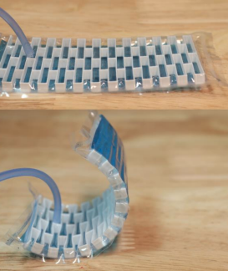
Topic Statement
Motivation:
Benefits of soft vs traditional robots
To improve modeling in Kraken
Goal - create a robot that is:
Soft
Capable of 3D operation
Nearly or fully untethered
Bioinspired
Example of bending ability
in soft actuators
P. Rayner, L. Morita, X. Sun and D. Sameoto, "R3VAMPs - Fully Recyclable, Reconfigurable, and Recoverable Vacuum Actuated Muscle-inspired Pneumatic structures,“
2022 IEEE 5th International Conference on Soft Robotics (RoboSoft), 2022, pp. 577-582, doi: 10.1109/RoboSoft54090.2022.9762163.

Slide 3
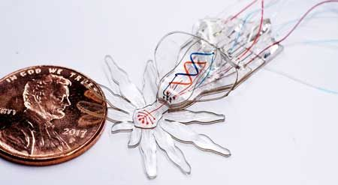
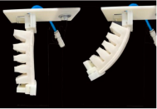
Literature Review (Background)
Papers involving pneumatics
Actuators, airflow dynamics, joints
“Increasing the Dimensionality of Soft Microstructures through Injection-Induced Self-Folding
Separate system for pneumatic control
Nearly untethered
Papers not involving pneumatics
Actuators, grippers, tensegrity
“Untethered Cable-Driven Soft Actuators for Quadruped Robots”
Completely untethered system possible
Hydraulic spider
Ranzani, Tommaso & Russo, Sheila & Bartlett, Nicholas & Wehner, Michael & Wood, Robert. (2018). Increasing the Dimensionality of Soft
Microstructures through Injection‐Induced Self‐Folding. Advanced Materials. 30. 10.1002/adma.201802739.
S. Gong, J. Wu, T. Zheng, W. -M. Zhang and L. Shao, "Untethered Cable-driven Soft Actuators for Quadruped Robots," 2021 27th International
Conference on Mechatronics and Machine Vision in Practice (M2VIP), 2021, pp. 417-422, doi: 10.1109/M2VIP49856.2021.9664995.
Example of cable actuator

Slide 4
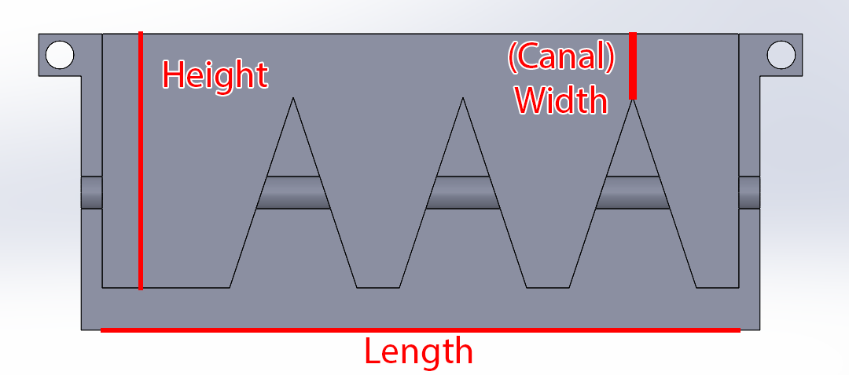
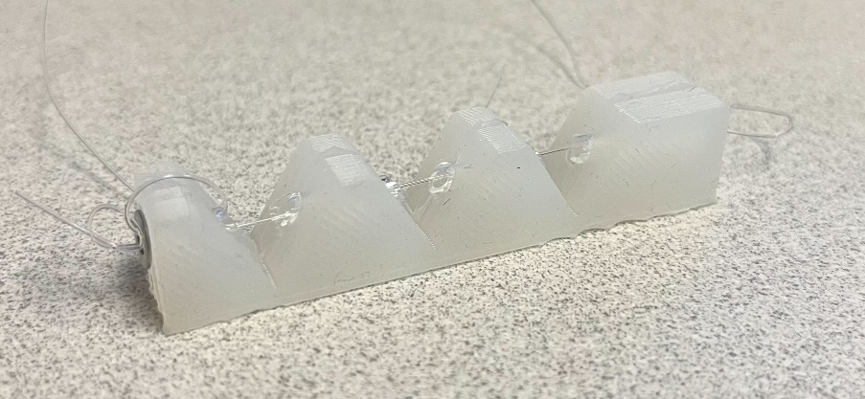
Progress Report – Material Testing
Two sets of molds
15mm vs 30mm height
2.5mm vs 7.5mm width
Tested one vs two cable design
Body Double
Cure time too fast, traps lots of bubbles
Ecoflex 50
Softer
Not much force required to bend
Dragon Skin 30
Stiffer
Significantly more force required to bend
Example mold
Example actuator
Screenshot of data taken

Slide 5
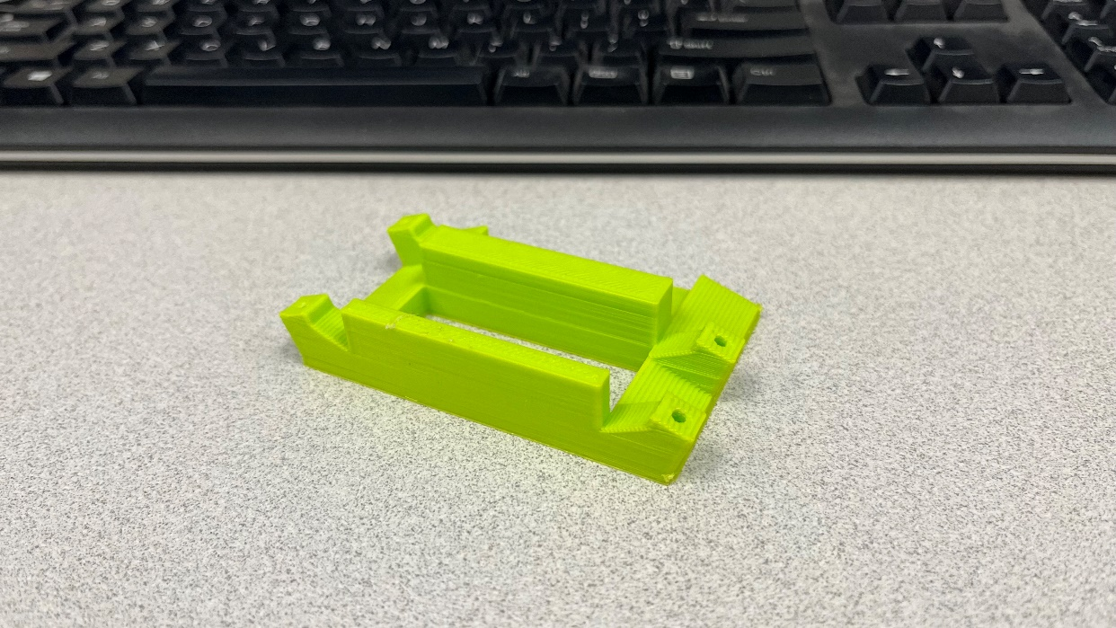
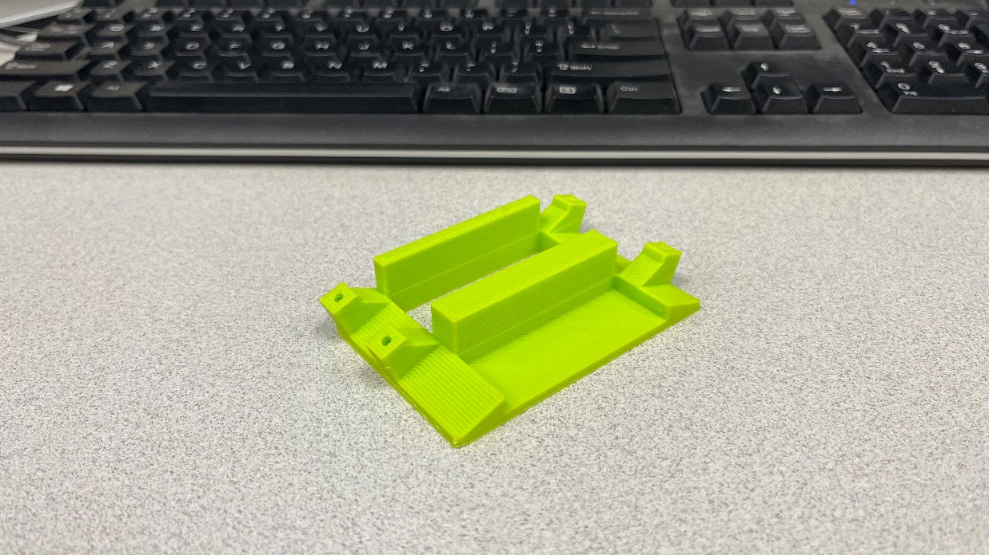
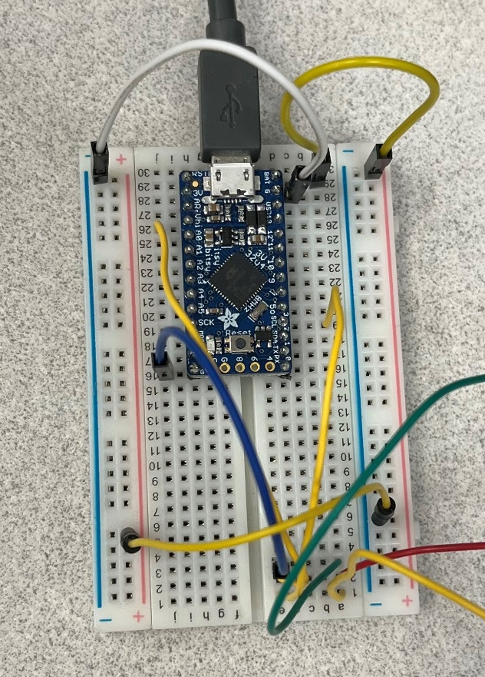
Progress Report – Prototyping and Initial Actuator Testing
3D-printed PLA body
Initial design for basic actuator testing
Circuit Design + Software
ItsyBitsy 3V board
Servo pulls one actuator, then the other
One “fin” moves at a time
Arduino IDE (easy servo manipulation)
Actuator Testing
Ecoflex too soft
Dragon Skin 30 with 7.5mm canals could move body
Approx. at least 4 N needed by actuator
1st Prototype (Front and Back view)
Testing circuit

Slide 6
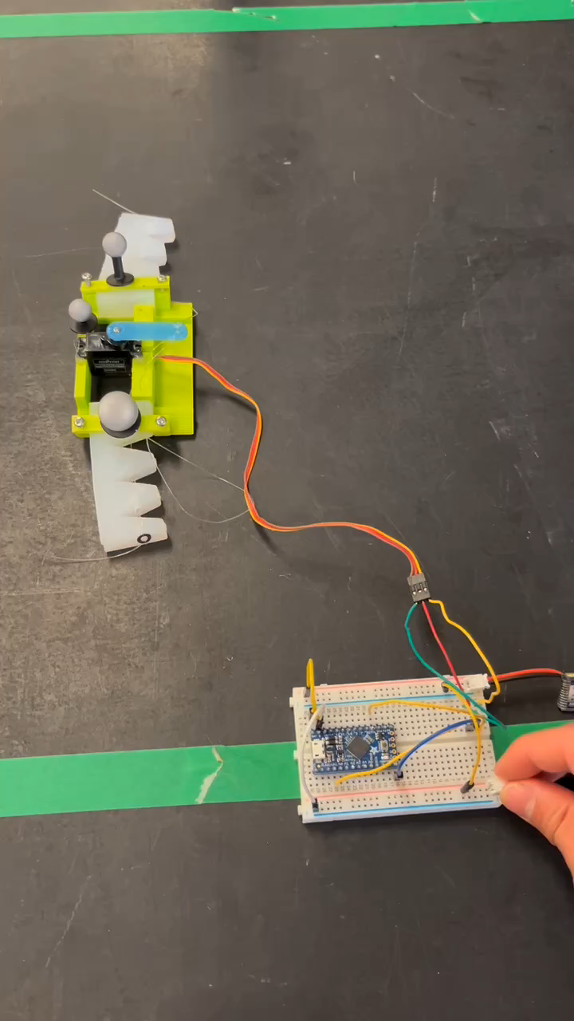
Demonstration

Slide 7
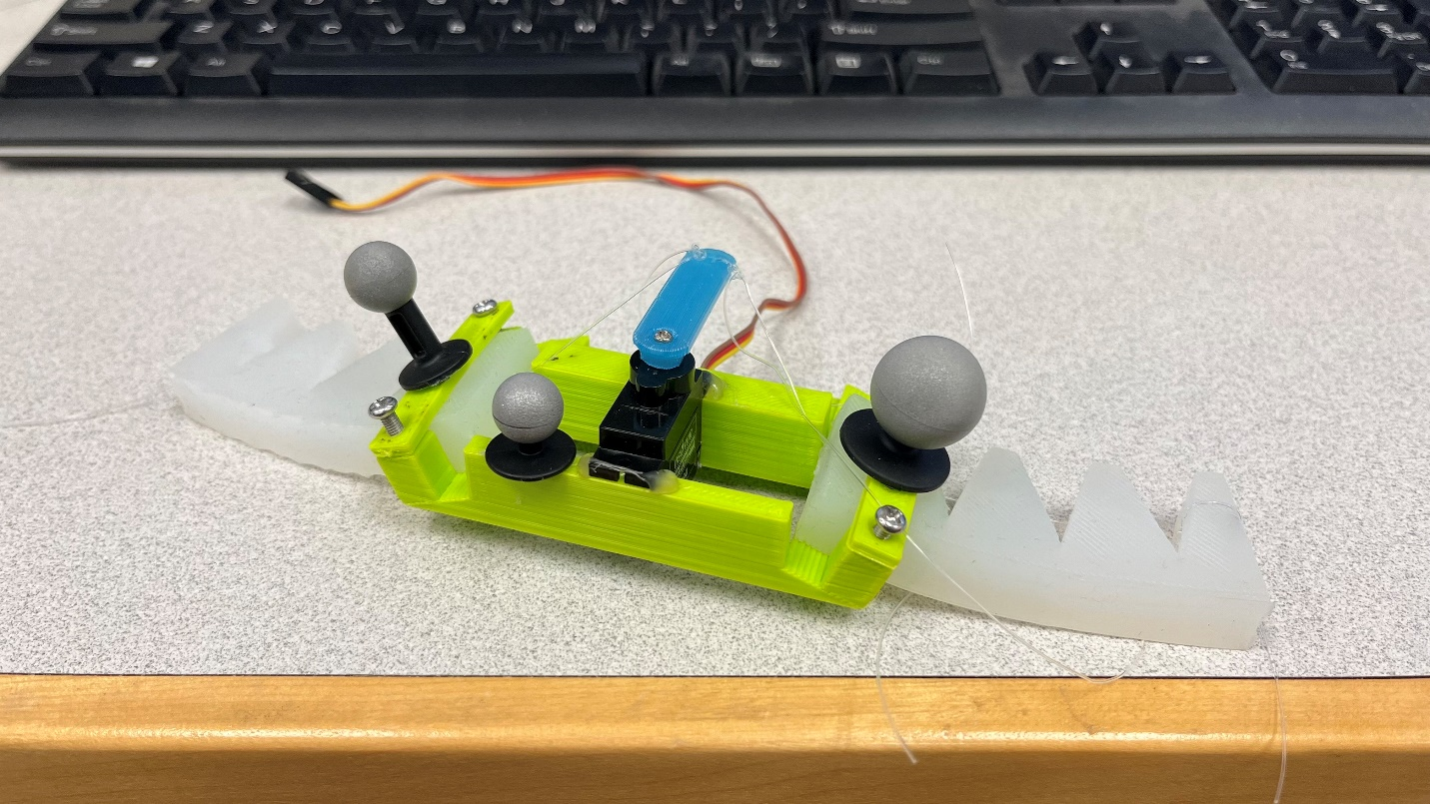
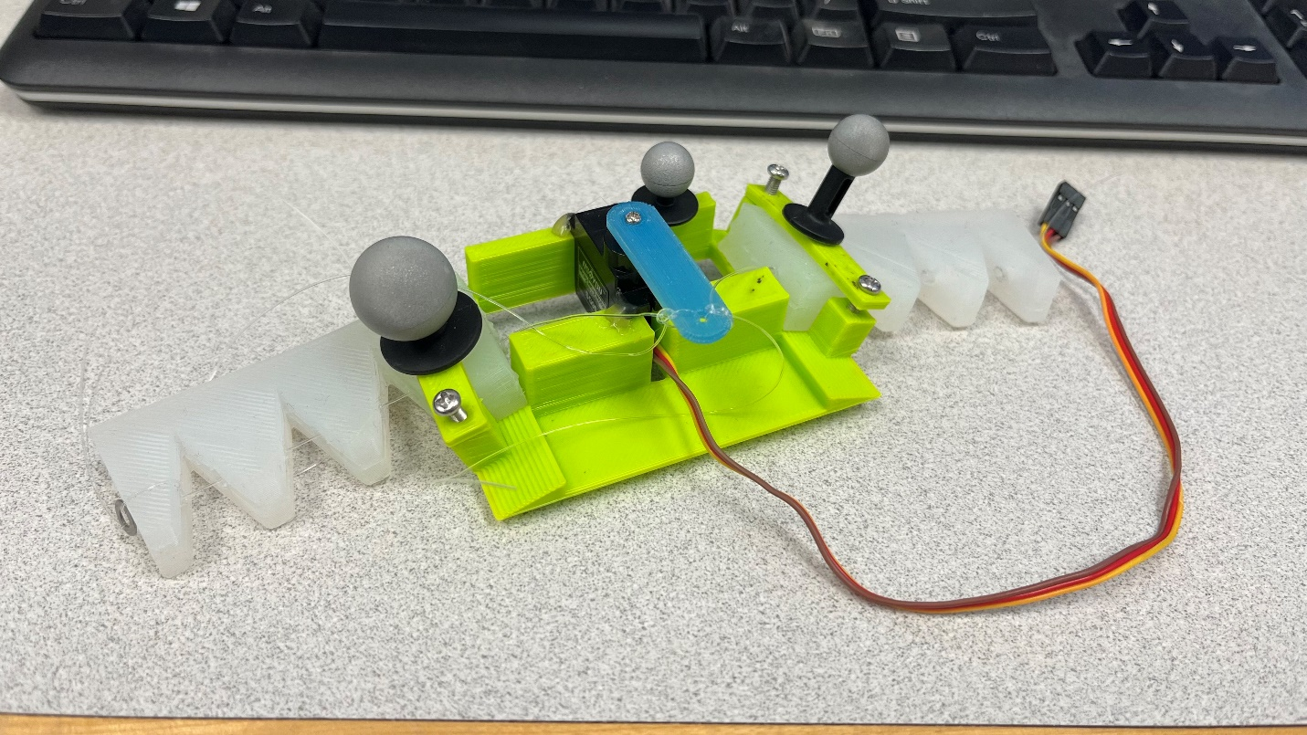
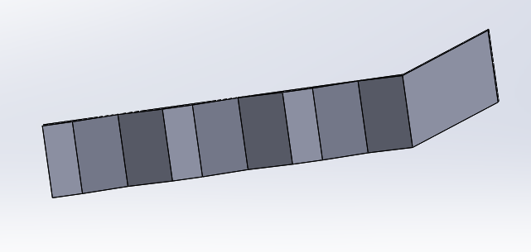
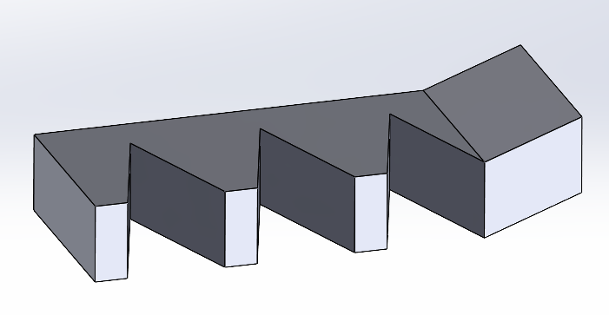
Progress Report – Further Actuator Design and Data Collection
Body Redesign
Better servo fit
15/30mm height compatible on both sides
Actuator Redesign
Introduce tilt at connection point with body
More surface area touching the ground
2nd Prototype (Front and Back view)
Tilted actuator model

Slide 8
Results
Mocap used for velocity tracking
Non-tilted, 30mm tall, 7.5 width performed best
Current hypothesis
Edge, not bottom surface of actuator impacts speed

Slide 9
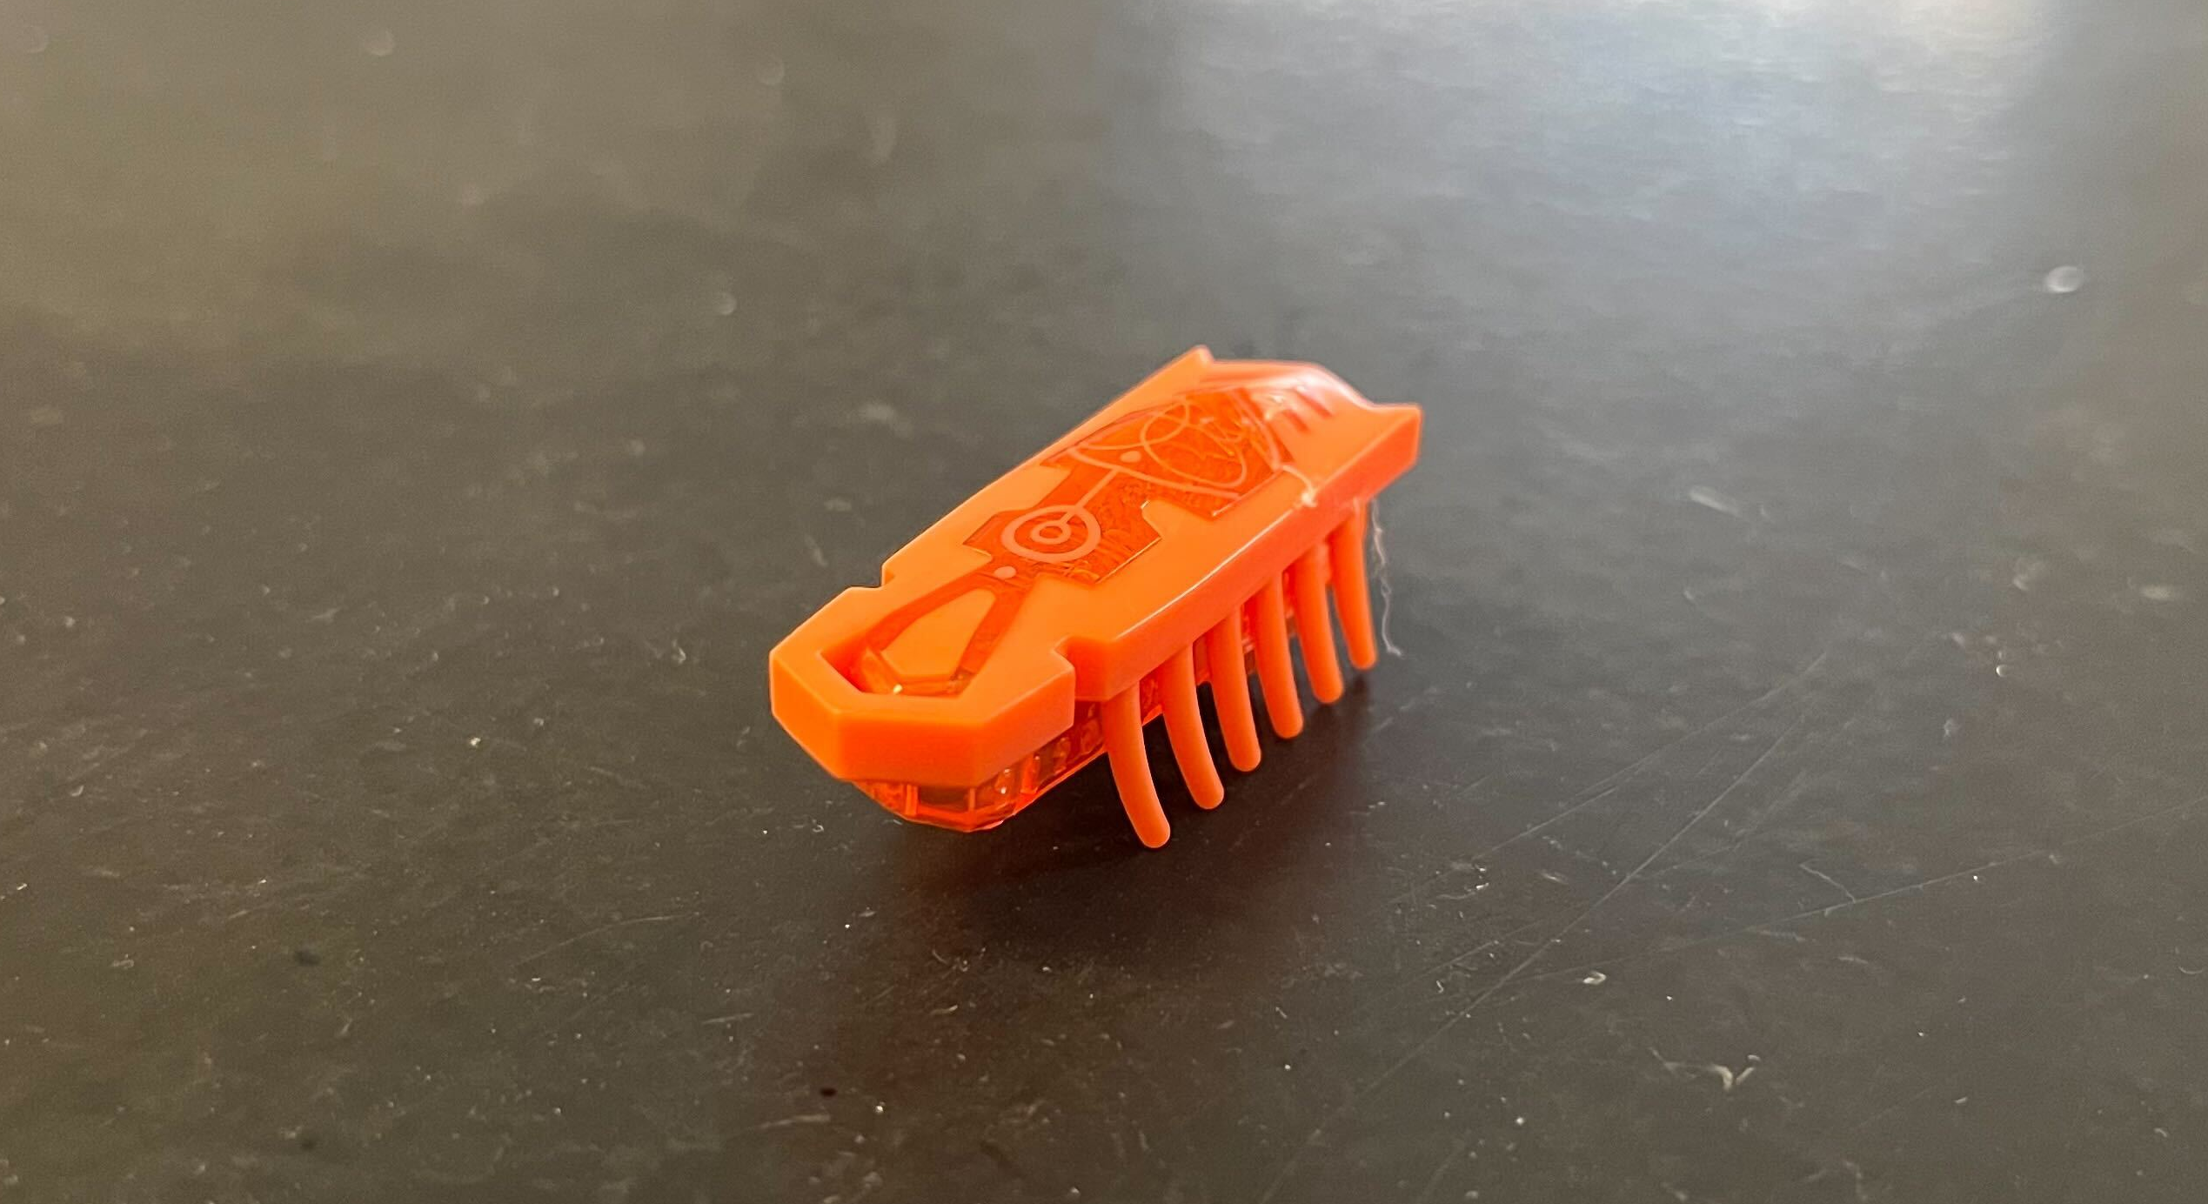
Future Work
Actuator
Add texturing to the bottom of actuator
Edges, legs, etc.
Structure
3D printed → soft body
Potential style of legs to use
in actuator design

